Slide 1
Web Applications CT050-3-2 (VD1)
Accessibility

Slide 2
Topic & Structure of The Lesson
Introduction
Web Accessibility
Web Accessibility Initiative
Providing Alternatives for Multimedia Content
Maximizing Readability by Focusing on Structure

Slide 3
Learning Outcomes
At the end of this topic, You should be able to
To introduce the World Wide Web Consortium’s Web Content Accessibility Guidelines.
To understand how to use the alt attribute of the img element to describe images to people with visual impairments, mobile-Web-device users, search engines, etc.

Slide 4
Key Terms You Must Be Able To Use
If you have mastered this topic, you should be able to use the following terms correctly in your assignments and exams:
Accessibility

Slide 5

Introduction
Accessibility
Level of usability of an application or Website for people with disabilities
Web sites
Majority are partially or totally inaccessible
Need to be accessible as more people
with disabilities use Internet
High level of accessibility
hard to obtain
Different disabilities
Language barriers
Hardware and software
inconsistencies

Slide 6
Web Accessibility
Enables individuals with disabilities to work in vast array of fields
Federal regulations require it to accommodate needs of people with hearing, vision, speech and mobility impairments

Slide 7


Web Accessibility Initiative
Web Accessibility Initiative (WAI™)
World Wide Web Consortium’s attempt to improve accessibility of Websites
Most Websites considered inaccessible
www.w3.org/WAI
Usability of an application or Web site by people with disability

Slide 8
Providing Alternatives for Multimedia Content
Web pages
Include a textual description that defines the purpose of every image
Use the alt attribute of img and input elements
Not using alt attribute increases difficulty of browsing the Web for certain individuals
alt attribute
Used for <img> and <input> tags
Provides a description of multimedia
Enable user agents to interpret page

Slide 9
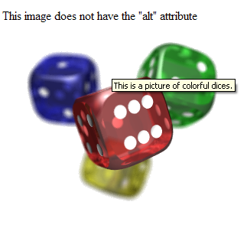
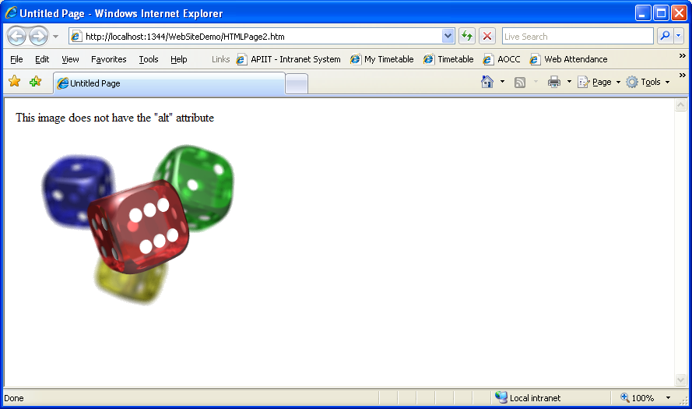
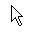
Providing Alternatives for Multimedia Content

Slide 10
Providing Alternatives for Multimedia Content
User agents
Program that interprets and translates a Web page
Access text-based information
Interpret and translate Web-page source code
Screen readers
Programs that allow users to hear all text displayed on screens
Read web pages aloud
Reads text descriptions accompanying alt attributes
Braille displays
Devices that receive data from screen-reading software
Convert Web pages to braille

Slide 11
Maximizing Readability by Focusing on Structure
Many Web sites use tags incorrectly
Used for aesthetic purposes rather than appropriate purposes
<h1> heading tag
Intended as a major section head for content
Used incorrectly to make text large and bold
Creates problems for screen readers since they verbally inform users that a new section has been reached
Use in accordance with its XHTML specifications
Readability
Consider the reading level of audience
Do not use slang and other non-traditional language

Slide 12
Accessibility in Tables
Screen readers
Many incapable of translating tables unless properly designed
Following example illustrates table
Has no accessibility modifications
Table contents not presented adequately
W3C recommends using Cascading Style Sheets instead of tables

Slide 13
Accessibility in Tables
Price of Fruit
Fruit | Price
Apple | $0.25
Orange | $0.50
Banana | $1.00
Pineapple | $2.00

Slide 14
Accessibility in Tables
Hard for screen readers to interpret
Read in a linearized manner
Start at top-left and read left to right, top to bottom
The table would be read:
Price of Fruit Fruit Price
Apple 0.25 Orange $0.50
Banana $1.00 Pineapple $2.00

Slide 15
Accessibility in HTML Tables
Following example illustrates HTML table
Has accessibility modifications
Contains <td> tag with headers attribute and <th> tag with id attribute

Slide 16
Accessibility in HTML Tables
Price of Fruit
Fruit | Price
Apple | $0.25
Orange | $0.50
Banana | $1.00
Pineapple | $2.00

Slide 17
Accessibility in Tables
Reads table as
Caption : Price of Fruit
Summary : This table uses TH and the
ID and HEADERS attributes to
make the table readable by
screen readers.
Fruit : Apple, Price: $0.25
Fruit : Orange, Price: $0.50
Fruit : Banana, Price: $1.00
Fruit : Pineapple, Price: $2.00

Slide 18
Quick Review Question
Discuss the way to ensure accessibility achieved in web pages.

Slide 19
Summary of Main Teaching Points
Accessibility

Slide 20
Question and Answer Session
Q & A

Slide 21
What we will cover next
Introduction to Servers and Security

